Slide 1



Telecom
Churn
Prediction
ML Capstone Project to predict customer churn in Telecom Industry
by Dheeraj Dua

Slide 2


Introduction
Countries like India have experienced a significant digital revolution, driven by plummeting data costs and decreasing cellphone prices. As a result, telecom providers now face intense competition and shrinking profit margins. The ability for customers to easily switch providers due to service quality issues has only intensified this challenge.
Customer churn in the telecom sector poses one of the most critical challenges for service providers worldwide. Retaining existing customers is notably more cost-effective than acquiring new ones.
The goal of this case study is to identify the key factors contributing to customer churn within the telecom industry. By understanding the underlying drivers of churn, we aim to develop a predictive model that can forecast customer churn, enabling companies to proactively address these issues. Such a model would empower companies to retain their customers by offering tailored counteroffers, bundled packages, discounts, and other incentives.

Slide 3
Problem Statement
Due to increasing churn rate of customers from last several quarters, the company has decided to dive deep into factors driving it. Past efforts in retaining customers have been reactive where the suggested steps were applied at the point of no return.
The idea is to use machine learning to predict the likelihood of churn for each customer and reasons behind it. These reasons could be different for each customer. This will help with targeted response tailored to customer’s preferences thereby helping them stay and improving customer loyalty.

Slide 4
Project Objective
Leverage given dataset to predict customer churn
Understanding main variables/features influencing customer churn
Provide insights to the business on factors impacting customer churn
Use various ML algorithms to build prediction models, evaluate the accuracy and performance of these models
Finding the best model and provide recommendations to the Business to improve customer churn

Slide 5

Project Approach
Understanding of the
Problem & dataset
Modeling
Understand the given dataset and its associated features
Use different ML algorithms to predict customer churn basis important features
1
2
3
4
Discovery
Recommendations
Leverage existing data and
perform exploratory data analysis(EDA) to
Generate actionable insights
Provide recommendations to the
business to improve customer churn

Slide 6

Part 1 Understanding of the Problem & Data

Slide 7
Dataset Overview
Telecom Churn Dateset.csv
Features
(7043 rows, 21 columns)
Target label
(7043 rows, Churn class label Yes/No)

Slide 8
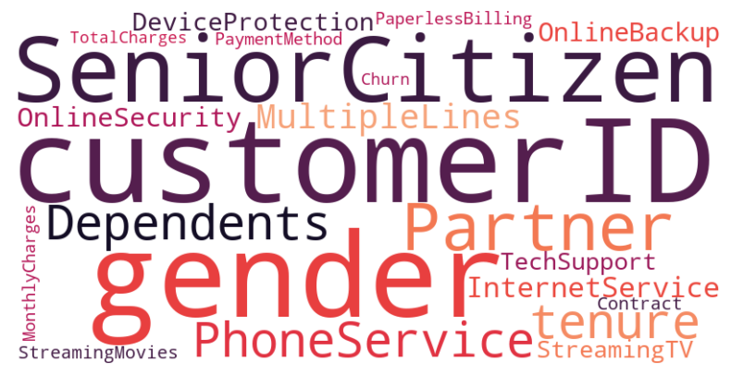
Name of the Features

Slide 9
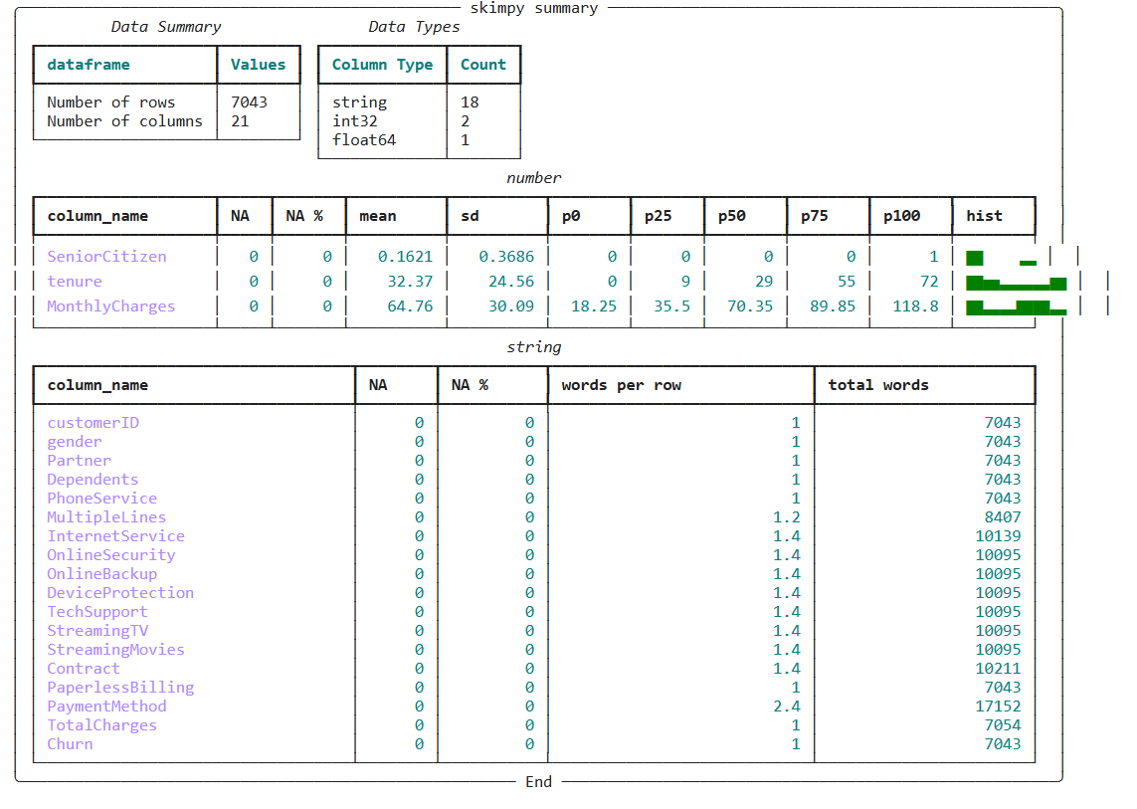
Data Summary

Slide 10
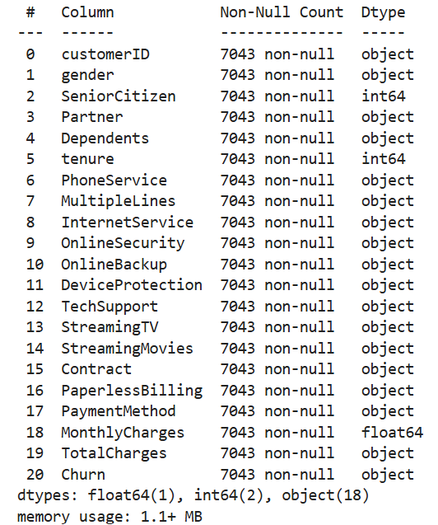
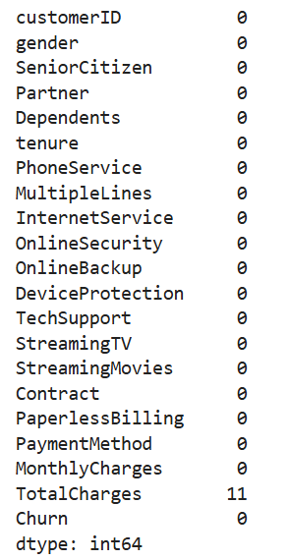
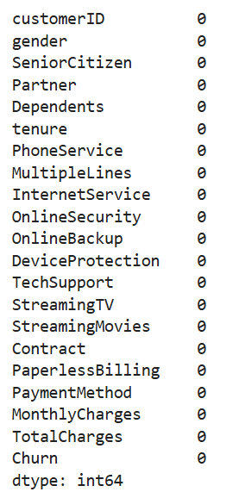
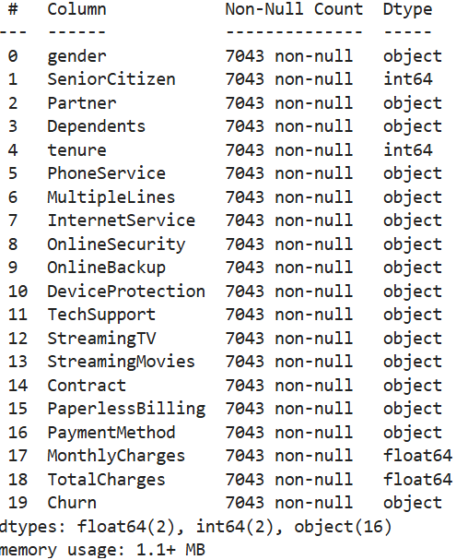
Data Preprocessing for Exploratory Data Analysis
Step 1 – Identify missing values
Step 2 –Impute missing values
Step 3- Remove ‘Customer’ id column
Converted format of ‘Total charges’ column into int column since the values are numeric
11 missing values were identified in ‘Total Charges’ column which are replaced by median of that column
No missing values were identified in other features or target column ‘Churn’
“Customer Id’ column is dropped from the dataset since it has no relevance

Slide 11

Part 2-
Exploratory
Data
Analysis

Slide 12
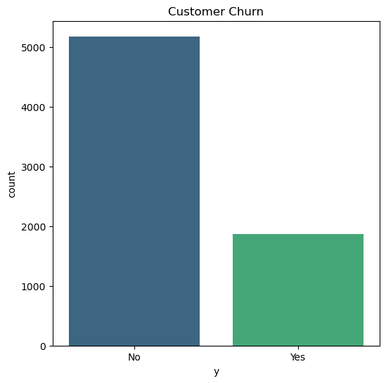
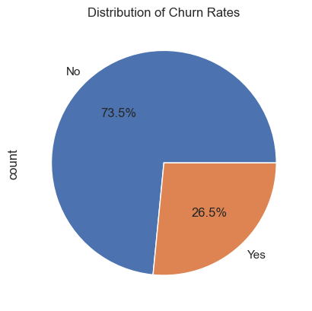
Understanding Target Variable
Target label Customer churn(y)
73.5% of customers have remained loyal to the telecom company, while 26.5% have switched to a different service provider
This means that for every 100 customers, approximately 27 are leaving, which can have a substantial impact on revenue and customer acquisition costs.

Slide 13
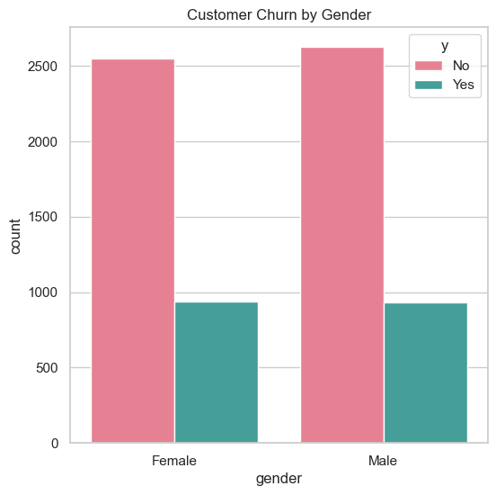
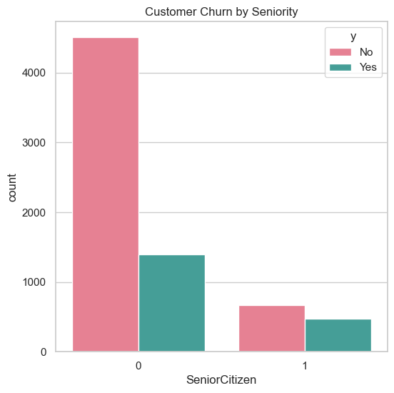
Bivariate Analysis – Gender and Seniority vs Customer Churn
Observations:
The churn rate is nearly identical for both male and female customers (Fig 1), indicating that gender does not influence customer churn
Fig 2 shows that senior citizens exhibit a significantly higher churn rate of approximately 40%, compared to younger customers whose churn rate is around 20%.

Slide 14
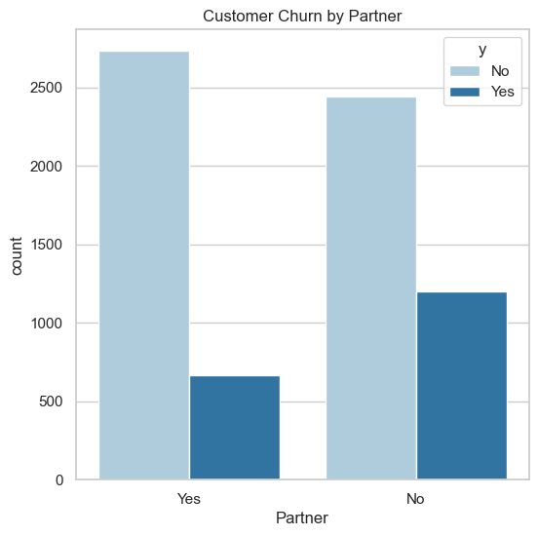
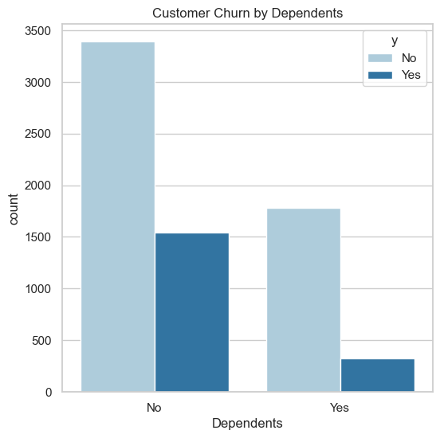
Bivariate Analysis – Partner and Dependents vs Customer Churn
Observations:
Figure 1 clearly shows that customers without a partner have a higher churn rate, reaching approximately 33% as compared to 20% for customers who have partner
Figure 2 clearly indicates that customers without dependents have a higher churn rate, reaching around 31%

Slide 15
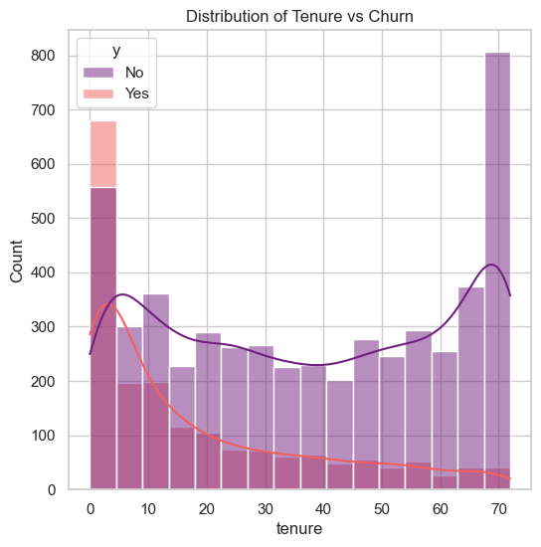
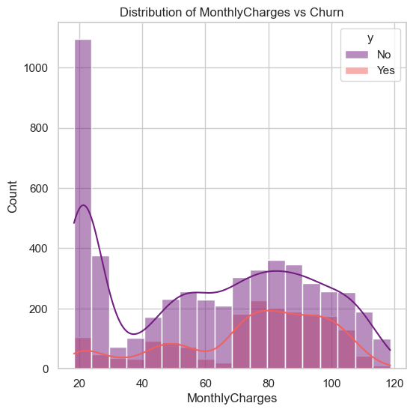
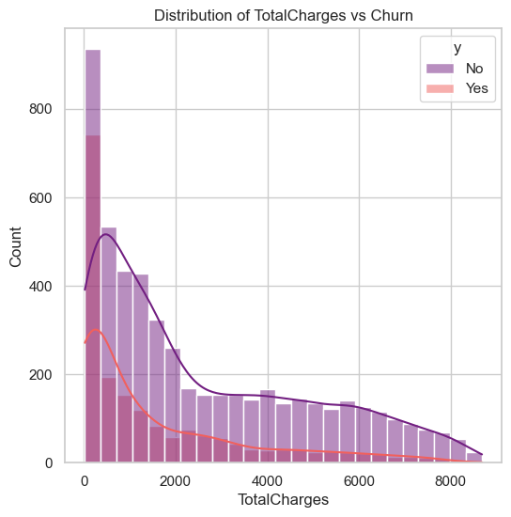
Distribution of Numerical features vs Churn
Observations:
Figure 1 shows that customer churn rate decreases as tenure increases, with the highest churn observed among customers with a tenure of 0–10 months, while those with the longest tenure have the lowest churn rate.
Figure 2 shows that Customer Churn is also notably higher for customers paying higher monthly charges, particularly in the range of ₹70 to ₹100.
Figure 3 shows the that the distribution of total charges is right-skewed, and churn tends to decline as total charges increase.
Exploring numerical features further could provide additional valuable insights.
Notes:
As tenure increases, the customer churn rate decreases, Customers with tenure between 0-10 months has higher churn rate
Customers with highest tenure has lowest churn rate
Customer Churn is high where monthly charges are higher especially between Rs.70 to Rs.100
Distribution of Total charges is skewed towards right
As the total charges increases the churn rate is decreasing
It would be interesting to dig deeper into numerical features to gather more insights

Slide 16
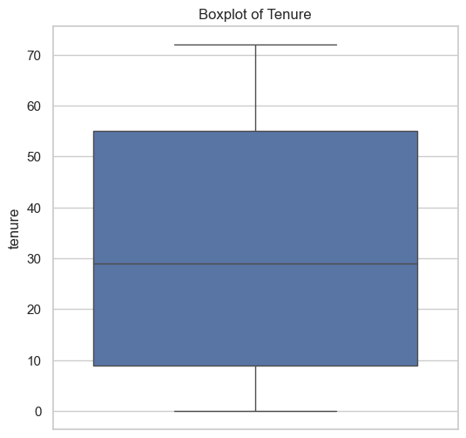
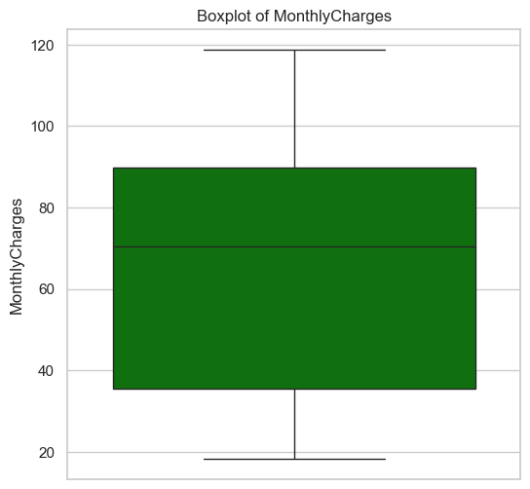
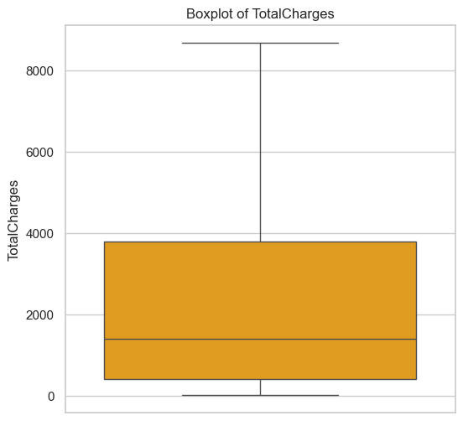
Box Plot to check Outliers in numerical features
Observations:
Figure 1 shows, the median tenure is approximately 30 days, and the tenure distribution appears symmetrical.
In Figure 2, The median monthly charges are around ₹65, aligning with the observation that churn increases as monthly charges rise
Figure 3 shows boxplot for total charges indicates a skewed distribution with high variance, and the median total charges are approximately ₹1500.
Notes:
No outliers are observed in any of the numerical feature mentioned above
Median tenure is around 30 days and the distribution of tenure is symmetrical
Median monthly charges are around Rs 65 as mentioned in the previous slide as Monthly charges increase customer churn also increases
Boxplot for Total Charges is skewed showing high variance and the median Total Charges are ~Rs 1500

Slide 17
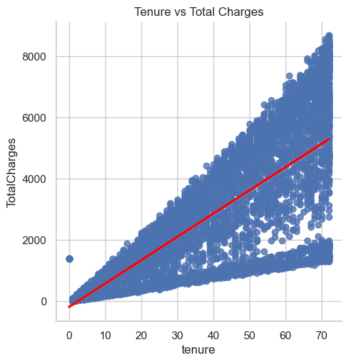
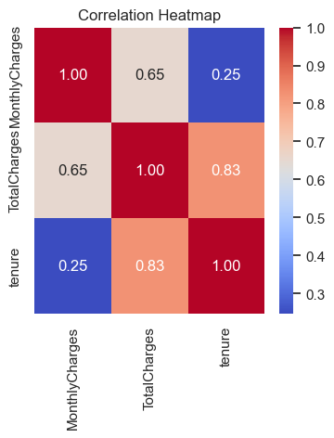
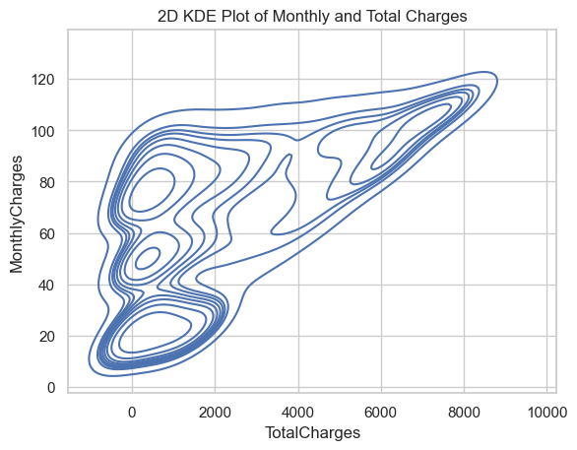
Studying relationship between numerical features
Observations:
It is evident from above KDE plot in Figure 1 that there are high density of customers who are at a lower end of the segment between 0-2000 total charges and 20-40 monthly charges
In Figure 1 there’s a positive trend, with higher Total Charges associated with higher Monthly Charges
Figure 2 shows positive correlation between Tenure and Total Charges
Figure 3 shows correlation summary of 3 numerical columns , since Tenure and Total Charges are highly correlated, we can drop one of the feature before model building preferably Total Charges column since it has higher variance
Notes:
Strong correlation found between Total Charges vs Tenure and Total Charges vs Monthly Charges
It is evident from the scatter plots above that customer churn is high during initial tenure of customers which needs to be looked into understand why customers leave during initial days of onboarding
Fig 2 shows relationship between Monthly and Total Charges; customers who are paying more than average of Monthly Charges tend to leave

Slide 18
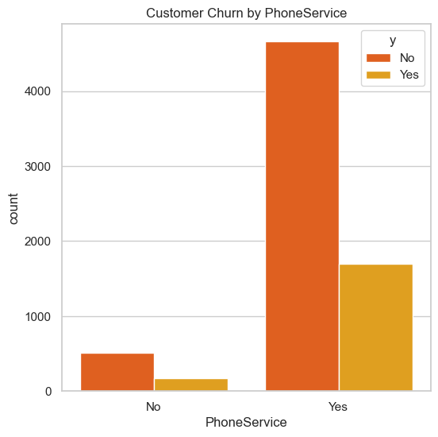
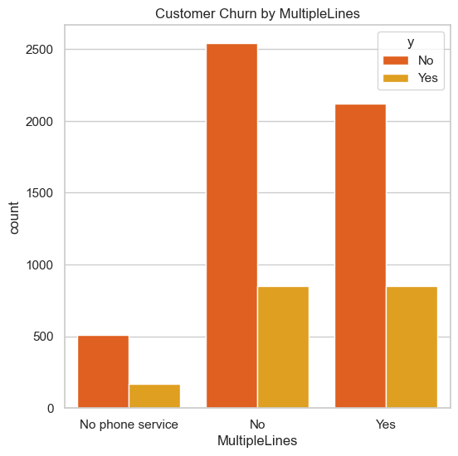
Customer Churn basis Phone Service
Observations:
In figure 1, proportion of customer is nearly same for customers who have phone service or who do not have phone service
Figure 2 shows that, nearly ~29% customers with Multiple lines tend to leave, 25% customers with no phone service leave

Slide 19
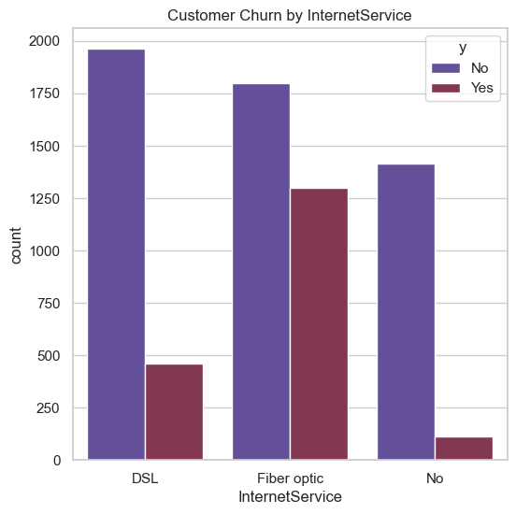
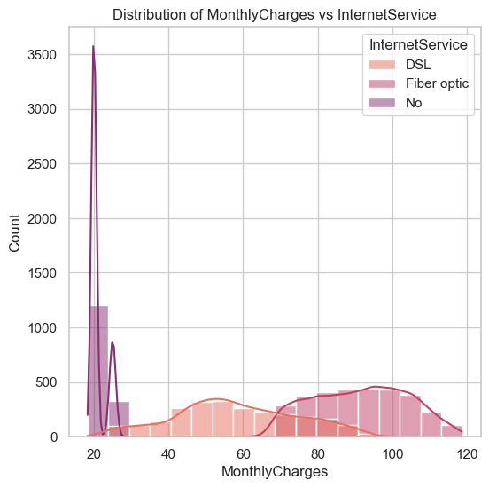
Customer Churn basis Internet Service
Observations:
As per figure 1, nearly 40% customers leave who have opted for Fiber Optic internet service as compared to 19% in case of DSL
From figure, It also implies, that average Monthly charges for Fiber Optic is much higher than customer who have opted for DSL
Churn rates for customers with paperless billing is nearly 2 times as compared to ones who have not opted for Paperless billing

Slide 20
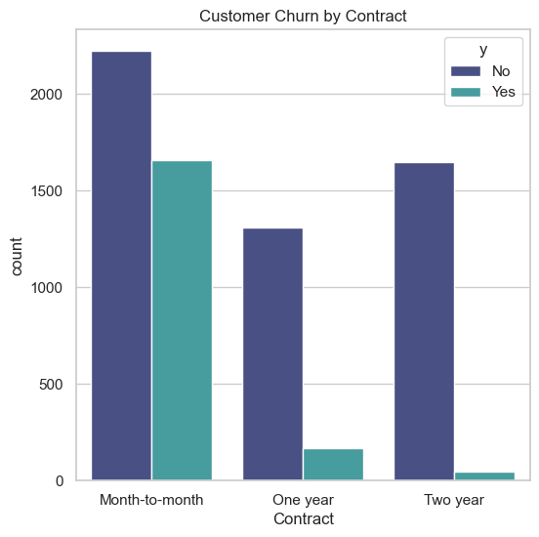
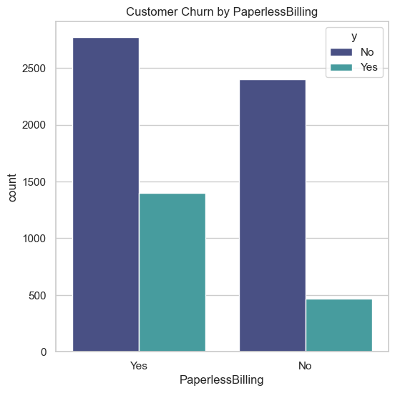
Customer Churn basis type of contract and Paperless Billing
Observations:
Figure 1 shows that 42% customers who have month to month contract are likely to leave, Churn rates are very less for customers who have either one- or 2-year contract; this indicates that company should put efforts to sign up customers for long term contracts like one or two years
Churn rates for customers with paperless billing is nearly 2 times as compared to ones who have not opted for Paperless billing which means that customer prefer to have paper bills rather than being on paperless billing

Slide 21
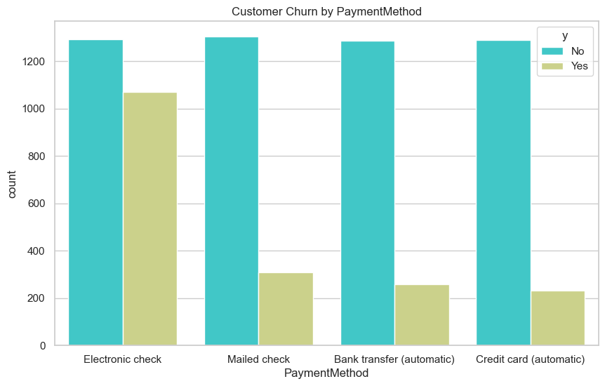
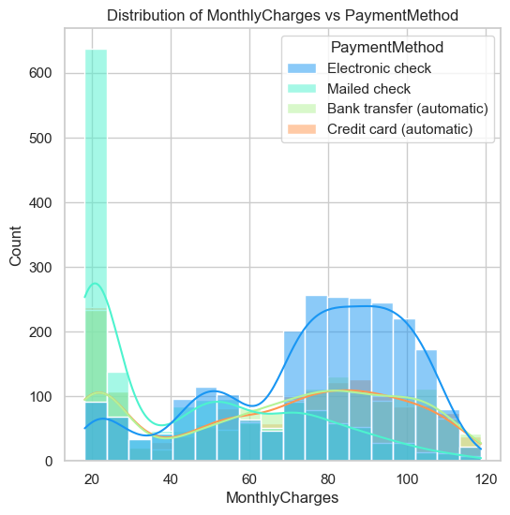
Customer Churn basis type payment method
Observations:
In Figure 1, nearly 45% of the customers who pay by electronic check are likely to leave as compared to other payment methods and the churn rate is lowest for customers who pay by Credit card and are set up on auto pay which is only ~15%
In Figure 2, customers who pay by electronic check are also paying higher monthly charges, It is important for the company to encourage these customers to opt for other payment methods before they decide to leave

Slide 22
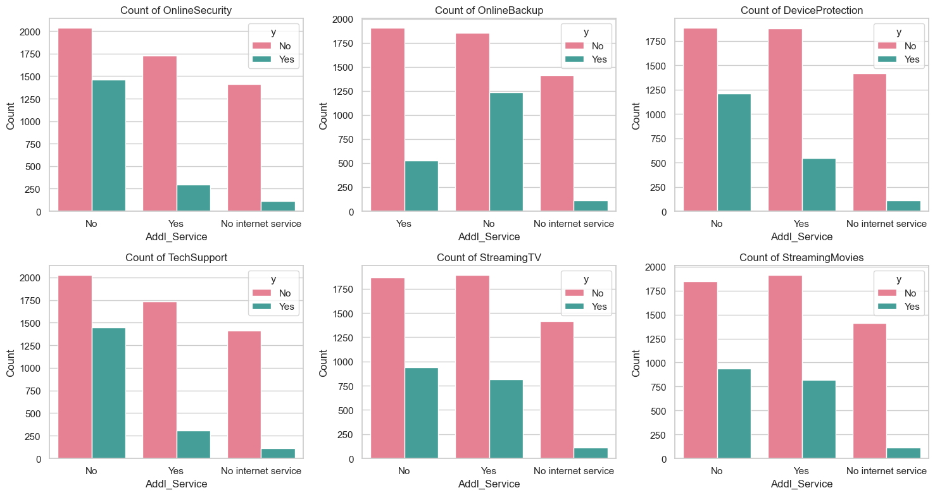
Customer Churn basis additional services
Summary of additional services categorical columns
Figure 1 shows that nearly 40% customers who have no Online security feature is likely to churn as compared to 14% for customers who do have online security
Figure 2 shows that nearly 40% customers with no online back up are likely to churn as compared to ones who have online back up
Fig 3 shows that nearly 40% customers who have not opted for device protection are likely to churn as compared to the ones who do have device protection
Fig 4 shows, nearly 40% customers who have not opted for Tech Support or have not reached out to Tech support are likely to have more churn rate
In figure 5 & 6, Streaming services or movies do not seem to have impact on churn rates

Slide 23
Customer Churn Analysis Summary
Overall Churn Rate:
Approximately 27% of customers leave the company, which means 1 out of 4 customers switch to a different service provider.
Gender Analysis:
Gender does not impact the churn rate, indicating that churn behavior is consistent across genders.
Age Impact:
Senior Citizens show a high churn rate of 40%, meaning nearly 2 out of 5 senior customers are likely to leave.
Marital Status:
Single customers are more prone to churn, with 1 out of every 3 likely to leave the company.
Dependents:
Customers with dependents have a churn rate of 30%, suggesting that 3 out of 10 such customers may switch services.
Customer Tenure:
Retention improves significantly after customers stay with the company for more than 10 days, showing a marked reduction in churn rates for longer-tenured customers.
The median tenure is approximately 30 days, and the distribution of tenure is symmetrical.
Monthly Charges:
Churn rate is notably high for customers with monthly charges between Rs. 70 to Rs. 100. This indicates that price sensitivity could be a factor influencing customers’ decisions to switch providers.
The median monthly charges are around Rs. 65.
Total Charges:
The distribution of total charges is skewed to the right, showing that most customers have accumulated lower total charges.
Churn rate decreases as total charges increase, suggesting that customers who spend more over time are more likely to remain loyal.
Internet Services:
Nearly 40% of customers with Fiber Optic internet service churn, compared to 19% for DSL users
Fiber Optic customers have higher average monthly charges than DSL customers
Additional Services:
Churn likelihood is close to 40% among customers without online security, online backup, device protection, or tech support, whereas customers with these services show significantly lower churn rates
Streaming and movie services do not appear to affect churn rates.
Notes:
Nearly, 40% customers churn who have opted for FiberOptic internet service as compared to 19% in case of DSL
Average Monthly charge for Fiber optic customers is much higher than customers who have opted for DSL
# Summary of additional services categorical columns# Nearly 40% customers who have no Online security feature is likely to churn as compared to 14% for customers who do have online security# Nearly 40% customers with no online back up are likely to churn as compared to ones who have online back up# Nearly 40% customers who have not opted for device protection are likely to churn as compared to the ones who do have device protection# Nearly 40% customers who have not opted for Tech Support or have not reached out to Tech support are likely to have more churn rate# Streaming services or movies do not seem to have impact on churn rates
# 42% customers who have month to month contract are likely to leave, Churn rates are very less for customers who have either one or 2 year contract
# Churn rates for customers with paperless billing is double as compared to ones who have not opted for Paperless billing
# Nearly 50% of the customers who pay by electronic check are likely to leave as compared to other payment methods\
C ]]

Slide 24
Customer Churn Analysis Summary
11. Customer Contracts:
Nearly 50% of customers are on month-to-month contracts
Churn is high (42%) for month-to-month contracts, while one- and two-year contracts have significantly lower churn rates.
Customers with two-year contracts have a very low churn rate of only 3%.
Paperless Billing:
60% of customers have chosen paperless billing
Nearly 50% of paperless billing customers churn, compared to just 20% of those with paper billing.
Payment Method:
Nearly equal number of customers pay by different payment methods
Almost 45% of customers who pay by electronic check are likely to churn, a much higher rate than other payment methods
Notes:
Nearly, 40% customers churn who have opted for FiberOptic internet service as compared to 19% in case of DSL
Average Monthly charge for Fiber optic customers is much higher than customers who have opted for DSL
# Summary of additional services categorical columns# Nearly 40% customers who have no Online security feature is likely to churn as compared to 14% for customers who do have online security# Nearly 40% customers with no online back up are likely to churn as compared to ones who have online back up# Nearly 40% customers who have not opted for device protection are likely to churn as compared to the ones who do have device protection# Nearly 40% customers who have not opted for Tech Support or have not reached out to Tech support are likely to have more churn rate# Streaming services or movies do not seem to have impact on churn rates
# 42% customers who have month to month contract are likely to leave, Churn rates are very less for customers who have either one or 2 year contract
# Churn rates for customers with paperless billing is double as compared to ones who have not opted for Paperless billing
# Nearly 50% of the customers who pay by electronic check are likely to leave as compared to other payment methods\
C ]]

Slide 25

Part 3- Building ML model

Slide 26
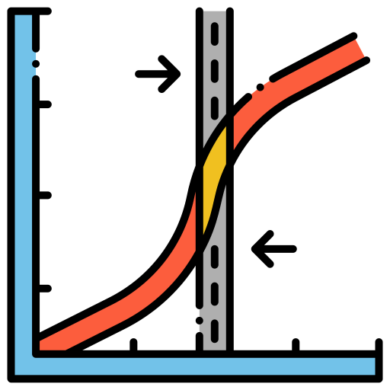
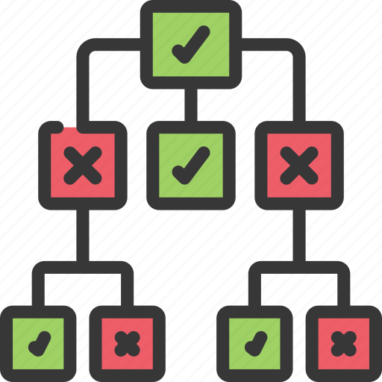

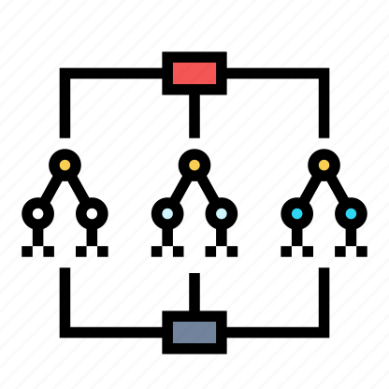

Accuracy Scores basis different ML Models using Cross Validation
Accuracy Score
Precision
Recall
F1 Score
76.89%
74.00%
80.00%
77.00%
Logistic
Regression
Accuracy Score:
Precision
Recall
F1 Score
79.04%
77.00%
82.00%
79.00%
Decision
Tree
Accuracy Score:
Precision
Recall
F1 Score
Random
Forest
84.61%
83.00%
87.00%
85.00%
Accuracy Score:
Precision
Recall
F1 Score
84.15%
81.00%
88.00%
84.00%
XGBoost

Slide 27

Part 4- Recommendations

Slide 28
Recommendations to improve Customer Churn
Focus on Senior Citizen Retention: Offer discounts, senior-specific support, or loyalty programs to retain senior customers.
Engage Single Customers: Provide exclusive bundles, perks, or loyalty programs for single customers to reduce churn.
Encourage Long-Term Contracts for New Customers: Offer limited-time discounts or loyalty rewards to encourage new customers to commit beyond the initial period.
Address Price Sensitivity in Monthly Charges: Revisit pricing for customers paying Rs. 70–100 per month, offering slight rate reductions or added perks.
Optimize Fiber Optic Service Offerings: Enhance Fiber Optic value with bundled services, premium support, or adjusted pricing to reduce churn.
Promote Essential Add-On Services: Encourage customers to opt for online security, backup, device protection, and tech support through discounts or free trials.
Encourage Long-Term Contracts: Offer incentives for month-to-month customers to switch to one- or two-year contracts to reduce churn.
Improve Paperless Billing Experience: Enhance paperless billing with reminders and loyalty rewards to reduce churn among these customers.
Promote Alternative Payment Methods: Encourage customers who pay by electronic check to switch to more stable payment methods, offering discounts or rewards.

Slide 29
Thank You

